Slide 1
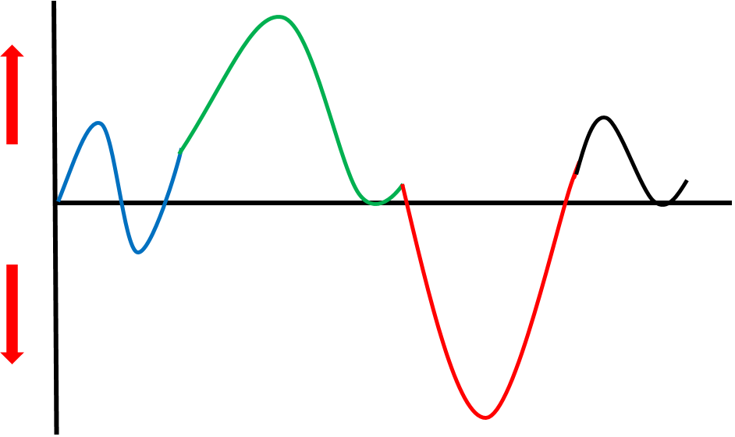
CONTEXTUAL BUSINESS PLAN
Area of Business | ✓  ✗ | Our Focus
Business Lifecycle
Personal Vision
Commercial Vision
Cultural Vision
Brand Promise
Growth Plan
Customer Journey
Operational Structure |  | % % % %
Skills and Training
Profit Formula
Documented Systems & Processes
Expectations Communicated and Managed
VISION
STRATEGY
© JacobAldridge.com 2020
RESOURCES
SYSTEMS
EXPECTATIONS

Slide 2
CONTEXTUAL BUSINESS PLAN - INSTRUCTIONS
✓ We do this really well  We’re OK ✗ This is a problem
Area of Business | ✓  ✗ | Focus
Business Lifecycle |  | Where in the Lifecycle are you aiming to go next? This may mean aiming to stay where you are for longer.
Personal Vision |  | What are some powerful elements of your Personal Vision?
Commercial Vision |  | What are the key elements of your Business Commercial Vision (eg, Revenue, Profit, Valuation)
Cultural Vision |  | What is your Business WHY / Purpose? What are your Core Values?
Brand Promise |  | What makes you special / famous? What do you stand for in your market?
Growth Plan |  | How fast do you want to grow? How do you want to feel as you grow? Do you have specific Capacity Targets?
Customer Journey |  | How do you want Customers to describe you? Do you have any targets around Conversion Rates or Lifetime Value?
Operational Structure |  | Overall Business Time across the 4 RNR Colours: Valuation, Growth, Revenue, Administration
Skills and Training |  | What is the Focus for your current Learning & Development Plan?
Profit Formula |  | Either your specific financial targets, or which financial areas you want to understand better
Documented Systems & Processes |  | What level of detail are you seeking here?
Expectations Communicated and Managed |  | How do you want to operate?
© JacobAldridge.com 2020

Slide 3
CONTEXTUAL BUSINESS PLAN – VIDEO LINKS
OVERVIEW: https://www.youtube.com/watch?v=MChIxfWqCSM
Area of Business | ✓  ✗ | Focus
Business Lifecycle |  | https://www.youtube.com/watch?v=wqwHLhHTjK8 https://www.youtube.com/watch?v=kSp755txoDE
Personal Vision |  | https://www.youtube.com/watch?v=ww5rFC4ReGY
Commercial Vision |  | https://www.youtube.com/watch?v=_9cnJoslCiA
Cultural Vision |  | https://www.youtube.com/watch?v=MpqbU3TRiVg
Brand Promise |  | https://www.youtube.com/watch?v=v7Vd_Erel4U
Growth Plan |  | https://www.youtube.com/watch?v=ocqeE_eql3E
Customer Journey |  | https://www.youtube.com/watch?v=1kXWd9bJYZg https://www.youtube.com/watch?v=GrJid1UEXbQ
Operational Structure |  | https://www.youtube.com/watch?v=Rnh5xd_60Oc
Skills and Training |  | https://www.youtube.com/watch?v=g-rOmEcIwls
Profit Formula |  | https://www.youtube.com/watch?v=-wU8bpbHkxk
Systems & Processes |  | https://www.youtube.com/watch?v=YdG0dUkWknQ
Expectations |  | https://www.youtube.com/watch?v=okS_TdVkjXo https://www.youtube.com/watch?v=8PH0leZNFAI
© JacobAldridge.com 2020

Slide 4
CONTEXTUAL BUSINESS PLAN - EXAMPLE
Area of Business | ✓  ✗ | Focus
Business Lifecycle |  | Confident
Personal Vision | ✗ | Comfortable, Kids, Small Boat
Commercial Vision |  | $10-12M, 15-20% Margin
Cultural Vision | ✓ | Staff feel safe, want to work here
Brand Promise | ✓ | Communication builds Quality
Growth Plan | ✓ | Steady, 60-80% Capacity
Customer Journey | ✗ | ‘Wow’ what a good experience
Operational Structure |  | 5% 40% 35% 20%
Skills and Training |  | Improve Quality, Time, Budget
Profit Formula |  | Know it back to front
Documented Systems & Processes | ✓ | Industry Leading for our size
Expectations Communicated and Managed |  | How we want to operate
VISION
STRATEGY
© JacobAldridge.com 2020
RESOURCES
SYSTEMS
EXPECTATIONS

